Slide 1
TF weather

Slide 2
Data windowing
The models in this tutorial will make a set of predictions based on a window of consecutive samples from the data.
The main features of the input windows are:
The width (number of time steps) of the input and label windows.
The time offset between them.
Which features are used as inputs, labels, or both.
This tutorial builds a variety of models (including Linear, DNN, CNN and RNN models), and uses them for both:
Single-output, and multi-output predictions.
Single-time-step and multi-time-step predictions.

Slide 3
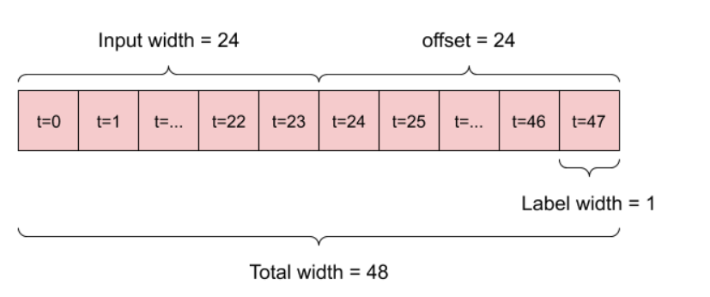
Data windowing single 24 hour
Depending on the task and type of model you may want to generate a variety of data windows. Here are some examples:
For example, to make a single prediction 24 hours into the future, given 24 hours of history, you might define a window like this:

Slide 4
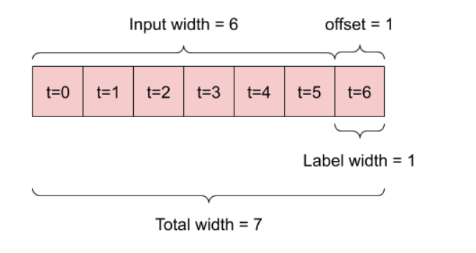
Data windowing single 1 hour
A model that makes a prediction one hour into the future, given six hours of history, would need a window like this:
For example, to make a single prediction 1 hours into the future, given 6 hours of history, you might define a window like this:

Slide 5
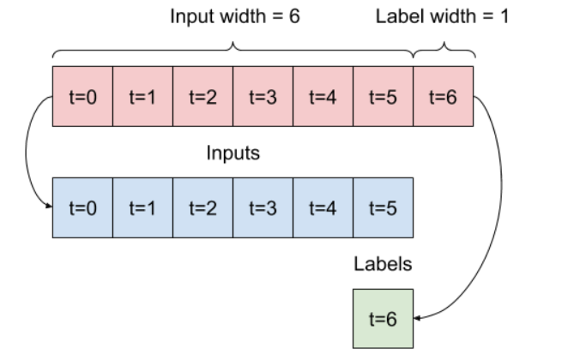
Split Data 1 hour
This diagram doesn't show the features axis of the data, but this split_window function also handles the label_columns so it can be used for both the single output and multi-output examples.
Given a list of consecutive inputs, the split_window method will convert them to a window of inputs and a window of labels.
The example w2 you define earlier will be split like this:
This diagram doesn't show the features axis of the data, but this split_window function also handles the label_columns so it can be used for both the single output and multi-output examples.

Slide 6
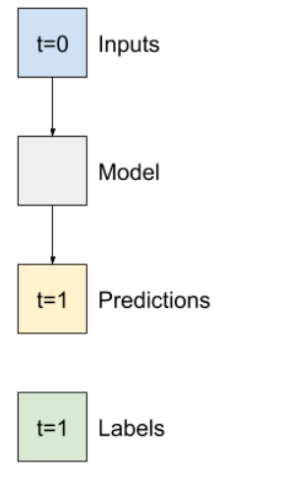
Single Step Models
Single step models
The simplest model you can build on this sort of data is one that predicts a single feature's value—1 time step (one hour) into the future based only on the current conditions.
So, start by building models to predict the T (degC) value one hour into the future.
Configure a WindowGenerator object to produce these single-step (input, label) pairs:

Slide 7
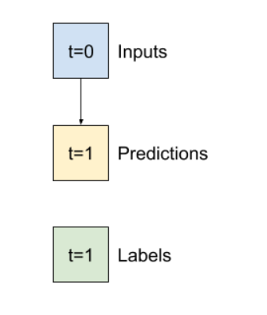
Baseline Model
Before building a trainable model it would be good to have a performance baseline as a point for comparison with the later more complicated models.
This first task is to predict temperature one hour into the future, given the current value of all features. The current values include the current temperature.
So, start with a model that just returns the current temperature as the prediction, predicting "No change". This is a reasonable baseline since temperature changes slowly. Of course, this baseline will work less well if you make a prediction further in the future.

Slide 8
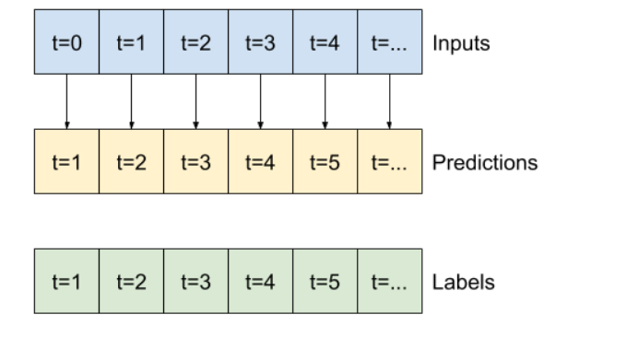
Expanded Baseline Model
This expanded window can be passed directly to the same baseline model without any code changes. This is possible because the inputs and labels have the same number of time steps, and the baseline just forwards the input to the output:

Slide 9
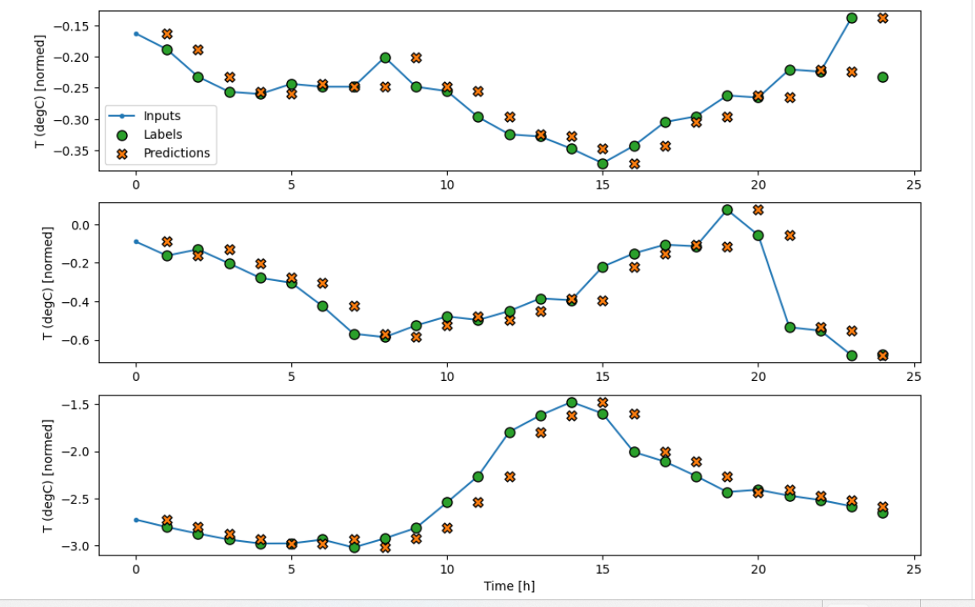
Expanded Baseline Model
The blue Inputs line shows the input temperature at each time step. The model receives all features, this plot only shows the temperature.
The green Labels dots show the target prediction value. These dots are shown at the prediction time, not the input time. That is why the range of labels is shifted 1 step relative to the inputs.
The orange Predictions crosses are the model's prediction's for each output time step. If the model were predicting perfectly the predictions would land directly on the Labels.

Slide 10
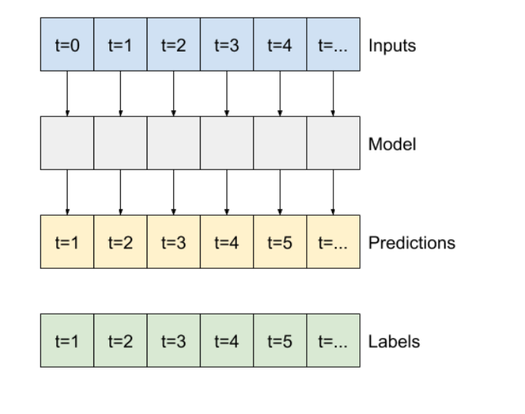
Linear Model
Like the baseline model, the linear model can be called on batches of wide windows. Used this way the model makes a set of independent predictions on consecutive time steps. The time axis acts like another batch axis. There are no interactions between the predictions at each time step.

Slide 11
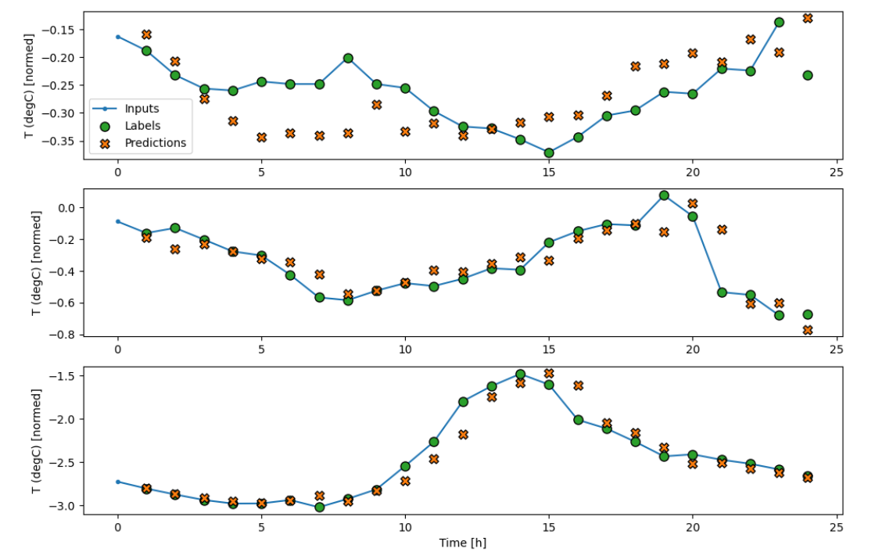
Linear Model
Here is the plot of its example predictions on the wide_window, note how in many cases the prediction is clearly better than just returning the input temperature, but in a few cases it's worse:
One advantage to linear models is that they're relatively simple to interpret. You can pull out the layer's weights and visualize the weight assigned to each input:

